Slide 1

Software requirements (swr302)
Requirements engineering good practices (chapter 03)

Slide 2
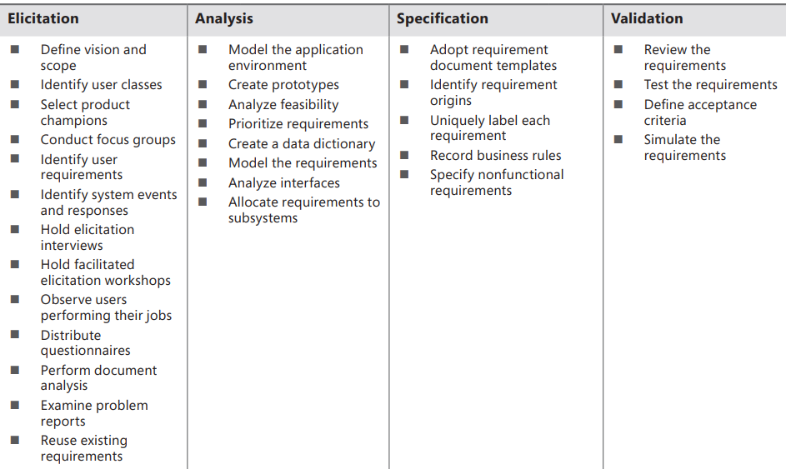
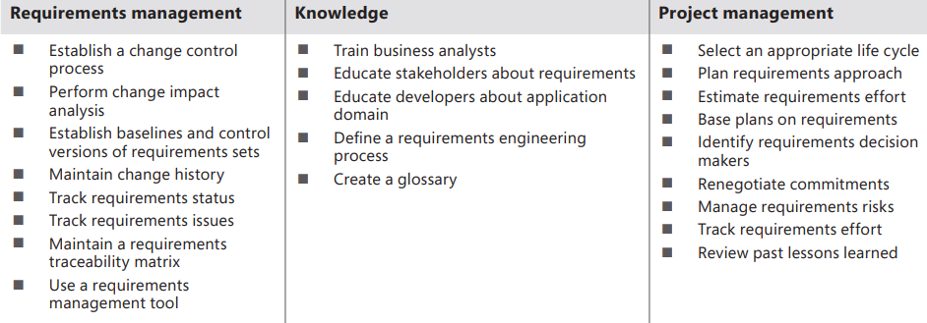
Requirements Engineering Components & Good Practices

Slide 3
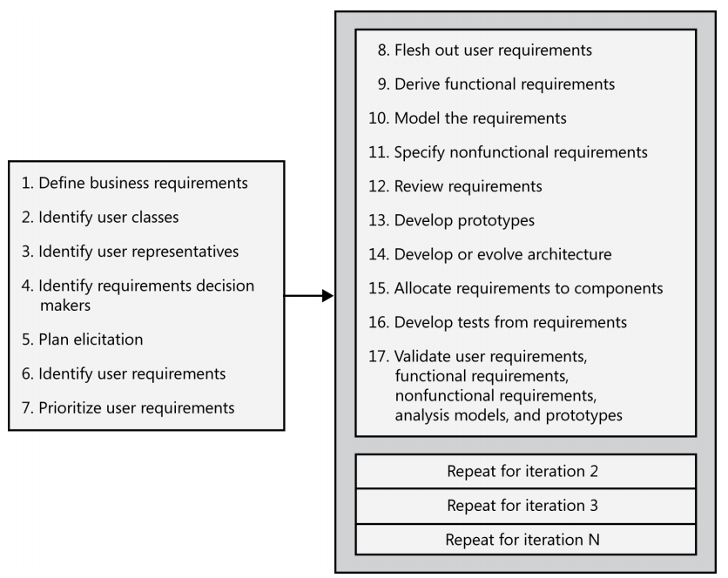
A Representative Requirements Requirement Development Process

Slide 4


